Slide 1
Design Algorithm and Analysis Assignment
Name: Venkata Sai Akhil Penugonda
Roll Number: 181210057
Branch : C.S.E
Topic : Graph Algorithms

Slide 2
Graph Traversal
In computer science, graph traversal (also known as graph search) refers to the process of visiting (checking and/or updating) each vertex in a graph. Such traversals are classified by the order in which the vertices are visited.
There are 2 types of graph traversal. They are:
1.Depth first search
2.Breath first search

Slide 3
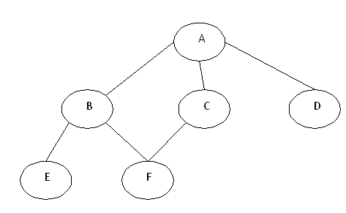
1.Depth First Search
The aim of DFS algorithm is to traverse the graph in such a way that it tries to go far from the root node. Stack is used in the implementation of the depth first search. Let’s see how depth first search works with respect to the following graph:
As stated before, in DFS, nodes are visited by going through the depth of the tree from the starting node. If we do the depth first traversal of the above graph and print the visited node, it will be “A B E F C D”. DFS visits the root node and then its children nodes until it reaches the end node, i.e. E and F nodes, then moves up to the parent nodes.

Slide 4
Algorithm for DFS
Step 1: Push the root node in the Stack.
Step 2: Loop until stack is empty.
Step 3: Peek the node of the stack.
Step 4: If the node has unvisited child nodes, get the unvisited child node, mark it as traversed and push it on stack.
Step 5: If the node does not have any unvisited child nodes, pop the node from the stack.

Slide 5
2.Breadth First Search
The aim of BFS algorithm is to traverse the graph as close as possible to the root node. Queue is used in the implementation of the breadth first search. Let’s see how BFS traversal works with respect to the following graph:
If we do the breadth first traversal of the above graph and print the visited node as the output, it will print the following output. “A B C D E F”. The BFS visits the nodes level by level, so it will start with level 0 which is the root node, and then it moves to the next levels which are B, C and D, then the last levels which are E and F.

Slide 6
Algorithm for BFS
Step 1: Push the root node in the Queue.
Step 2: Loop until the queue is empty.
Step 3: Remove the node from the Queue.
Step 4: If the removed node has unvisited child nodes, mark them as visited and insert the unvisited children in the queue.

Slide 7
Minimum Spanning Tree
A minimum spanning tree (MST) or minimum weight spanning tree is a subset of the edges of a connected, edge-weighted undirected graph that connects all the vertices together, without any cycles and with the minimum possible total edge weight. That is, it is a spanning tree whose sum of edge weights is as small as possible.
There are 2 methods for finding minimum spanning tree :
1.Prim’s Algorithm
2.Kruskal’s Algorithm

Slide 8
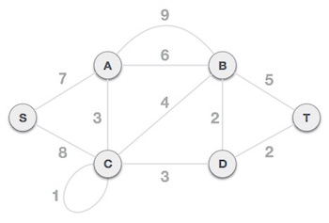
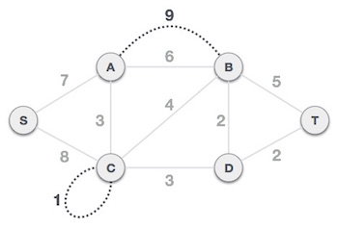
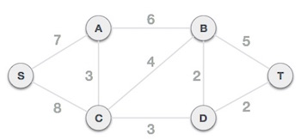
Prim’s Algorithm with example
Step 1 - Remove all loops and parallel edges
Remove all loops and parallel edges from the given graph. In case of parallel edges, keep the one which has the least cost associated and remove all others.
Example
---------->

Slide 9
Step 2 - Choose any arbitrary node as root node
In this case, we choose S node as the root node of Prim's spanning tree. This node is arbitrarily chosen, so any node can be the root node. One may wonder why any video can be a root node. So the answer is, in the spanning tree all the nodes of a graph are included and because it is connected then there must be at least one edge, which will join it to the rest of the tree.
Step 3 - Check outgoing edges and select the one with less cost
After choosing the root node S, we see that S,A and S,C are two edges with weight 7 and 8, respectively. We choose the edge S,A as it is lesser than the other.

Slide 10
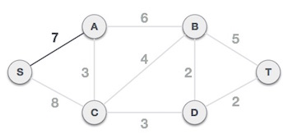
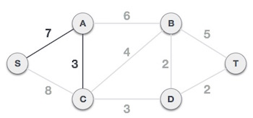
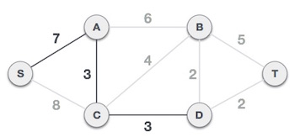
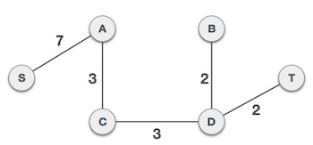
Now, the tree S-7-A is treated as one node and we check for all edges going out from it. We select the one which has the lowest cost and include it in the tree.
After this step, S-7-A-3-C tree is formed. Now we'll again treat it as a node and will check all the edges again. However, we will choose only the least cost edge. In this case, C-3-D is the new edge, which is less than other edges' cost 8, 6, 4, etc.
After adding node D to the spanning tree, we now have two edges going out of it having the same cost, i.e. D-2-T and D-2-B. Thus, we can add either one. But the next step will again yield edge 2 as the least cost. Hence, we are showing a spanning tree with both edges included.

Slide 11
Kruskal’s Algorithm with Example
Step 1 - Remove all loops and Parallel Edges
Remove all loops and parallel edges from the given graph.
In case of parallel edges, keep the one which has the least cost associated and remove all others.
Example
------------->

Slide 12

Step 2 - Arrange all edges in their increasing order of weight The next step is to create a set of edges and weight, and arrange them in an ascending order of weightage (cost).
Step 3 - Add the edge which has the least weightage
Now we start adding edges to the graph beginning from the one which has the least weight. Throughout, we shall keep checking that the spanning properties remain intact. In case, by adding one edge, the spanning tree property does not hold then we shall consider not to include the edge in the graph.

Slide 13
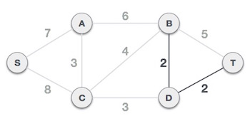
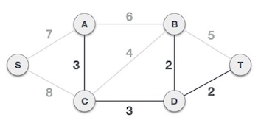
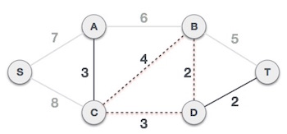
The least cost is 2 and edges involved are B,D and D,T. We add them. Adding them does not violate spanning tree properties, so we continue to our next edge selection.
Next cost is 3, and associated edges are A,C and C,D. We add them again
Next cost in the table is 4, and we observe that adding it will create a circuit in the graph. −
We ignore it. In the process we shall ignore/avoid all edges that create a circuit.

Slide 14
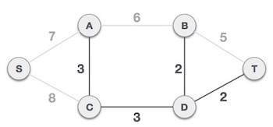
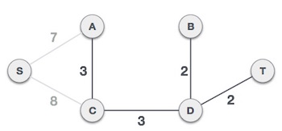
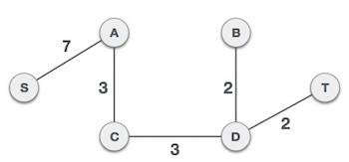
We observe that edges with cost 5 and 6 also create circuits. We ignore them and move on.
Now we are left with only one node to be added. Between the two least cost edges available 7 and 8, we shall add the edge with cost 7.
By adding edge S,A we have included all the nodes of the graph and we now have minimum cost spanning tree.

Slide 15
Single Source Shortest Path
The single-source shortest path problem, in which we have to find shortest paths from a source vertex v to all other vertices in the graph.
The algorithms used for performing this task are:
Dijkstra’s algorithm: it uses greedy approach
Bellman Ford’s algorithm : it uses dynamic programming approach

Slide 16
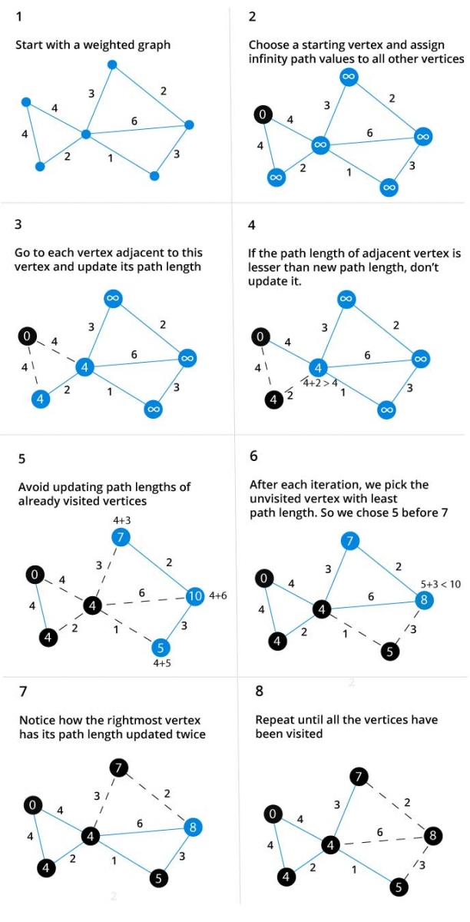
Dijkstra’s Algorithm (Pseudo code & Example)
function dijkstra(G, S)
for each vertex V in G
distance[V] <- infinite
previous[V] <- NULL
If V != S, add V to Priority Queue Q
distance[S] <- 0
while Q IS NOT EMPTY
U <- Extract MIN from Q
for each unvisited neighbour V of U
tempDistance <- distance[U] + edge_weight(U, V)
if tempDistance < distance[V]
distance[V] <- tempDistance
previous[V] <- U
return distance[], previous[]

Slide 17
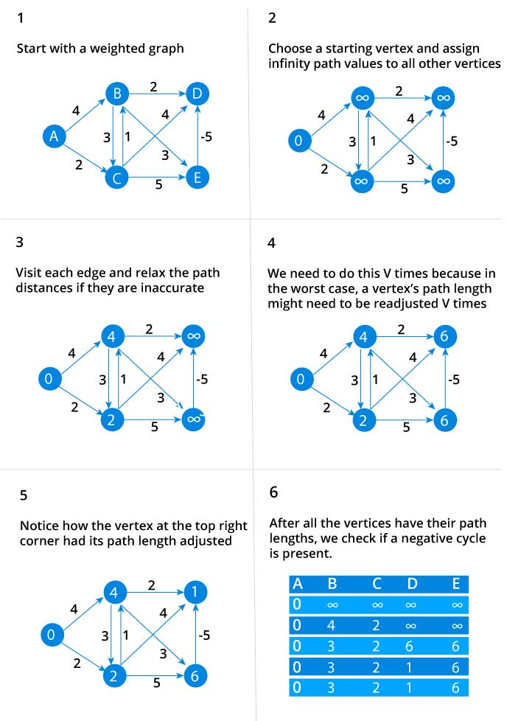
Bellman Ford’s algorithm(Pseudo code &Example)
function bellmanFord(G, S)
for each vertex V in G
distance[V] <- infinite
previous[V] <- NULL
distance[S] <- 0
for each vertex V in G
for each edge (U,V) in G
tempDistance <- distance[U] + edge_weight(U, V)
if tempDistance < distance[V]
distance[V] <- tempDistance
previous[V] <- U
for each edge (U,V) in G
If distance[U] + edge_weight(U, V) < distance[V}
Error: Negative Cycle Exists
return distance[], previous[]

Slide 18
All Pair Shortest Path
The all-pairs shortest path problem is the determination of the shortest graph distances between every pair of vertices in a given graph. The problem can be solved by using Dijkashtra's algorithm for each vertex or all at once using the Floyd-Warshall algorithm.
Floyd-Warshall is efficient in those two methods

Slide 19
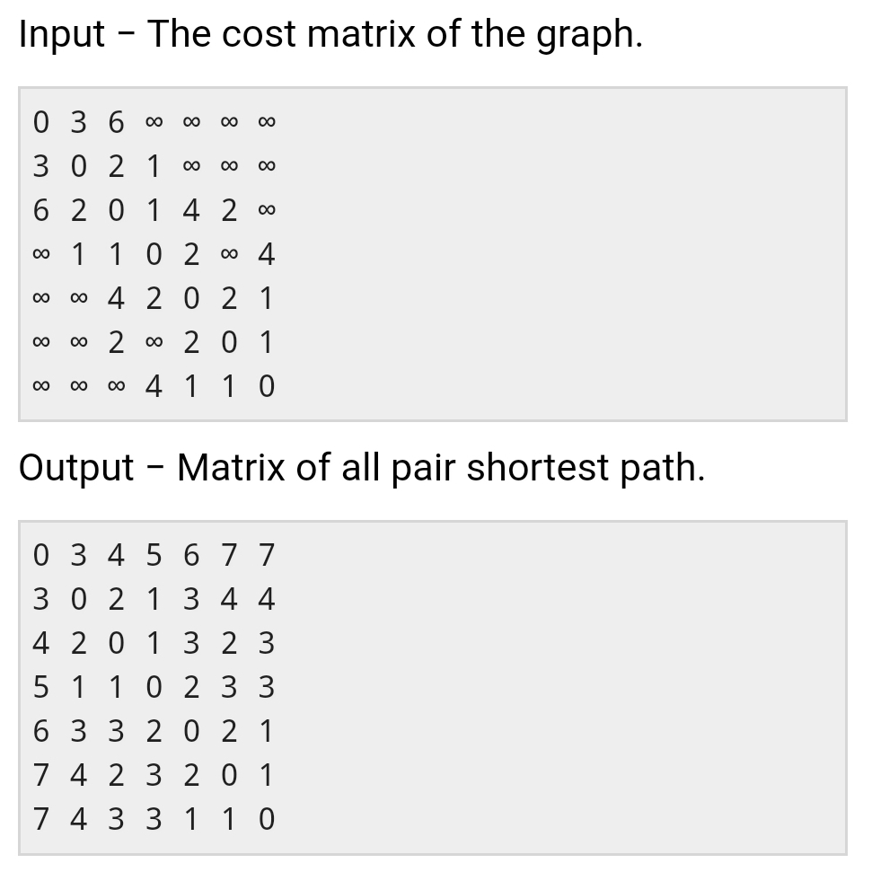
Floyd-Warshall Algorithm
Example
Begin
for k := 0 to n, do
for i := 0 to n, do
for j := 0 to n, do
if cost[i,k] + cost[k,j] < cost[i,j], then
cost[i,j] := cost[i,k] + cost[j,k]
done
done
done
display the current cost matrix
End

